Slide 1
Lecture 10
8086 Microprocessor
Bus Cycle

Slide 2
8086 Bus Cycle
To transfer data or fetch instruction from memory and other external devices using the system bus processor executes a bus cycle.
The minimum bus cycle consist of four clock periods or T states.
For communication with slower devices it can take many clock cycles required by the device.
The sequence of activities are: address, read/write and some other signals, data, and termination of the bus cycle.

Slide 3
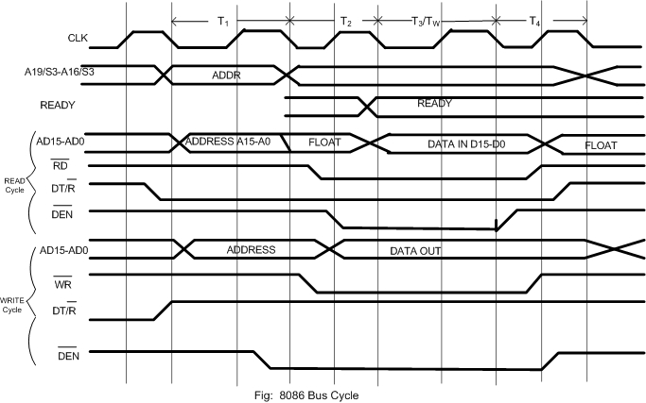
8086 Bus Cycle Timing diagram

Slide 4
8086 Bus Cycle: Read Cycle
First T state (T1):
  20 bit address is on address/data (AD15-AD0) and address/status (A16/S3-A19/S6) bus
  Processor output LOW on DT/R continues till T4.
Second T State (T2):
  AD15-AD0 lines are tri-stated
  A16/S3-A19/S6 switch from A16-A19 to status S3-S6.
  Processor output low on RD and DEN continues till T4.

Slide 5
8086 Bus Cycle: Read Cycle
Third T state (T3/Tw):
  8086 continues status S3-S6
  Input data on AD15-AD0 come from memory or external devices
  Slow memory or I/O devices activate READY input line by the start of T3. Processor inserts additional clock cycles (Tw) until device completes transfer and inputs HIGH on READY pin.
  During Tw other lines continues as T3.
  At the end of this T state data on AD15-AD0 are latched.
Fourth T state (T4):
  Processor disables the command lines
  Bus cycle is terminated.

Slide 6
8086 Bus Cycle Timing diagram

Slide 7
8086 Bus Cycle: Write Cycle
First T state (T1):
  20 bit address is on address/data (AD15-AD0) and address/status (A16/S3-A19/S6) bus
  Processor output HIGH on DT/R continues till T4.
Second T State (T2):
  AD15-AD0 lines are tri-stated
  A16/S3-A19/S6 switch from A16-A19 to status S3-S6.
  Processor output low on WR and DEN continues till T4.

Slide 8
8086 Bus Cycle: Write Cycle
Third T state (T3/Tw):
  8086 continues status S3-S6
  Input data on AD15-AD0 come from memory or external devices
  Slow memory or I/O devices activate READY input line by the start of T3. Processor inserts additional clock cycles (Tw) until device completes transfer and inputs HIGH on READY pin.
  During Tw other lines continues as T3.
  At the end of this T state data on AD15-AD0 are latched.
Fourth T state (T4):
  Processor disables the command lines
  Bus cycle is terminated.

Slide 9
Address Space & Memory

Slide 10
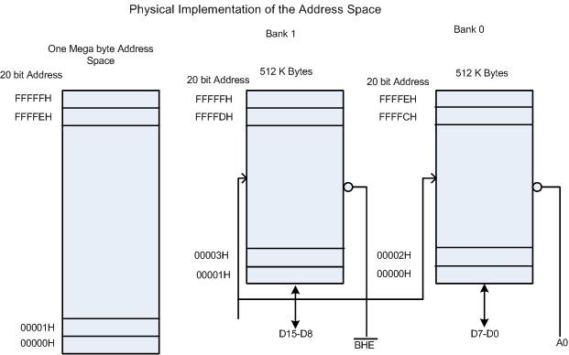
Address Space and Memory Bank
Memory is divided into two Banks up to 512K bytes each
A19-A1

Slide 11
Address Space and Memory Bank
Odd addressed bank is connected to D15-D8
Even addressed bank is connected to D7-D0
These banks are selected by BHE and A0 as follows:
  BHE A0
  0 0 Both Banks
  0 1 Odd address Bank
  1 0 Even Address Bank
  1 1 None

Slide 12
Example:
MOV DH, [BX],
  Byte operation
  Suppose 20 bit physical address is even (e.g 20004H), 8086 outputs LOW on A0 and HIGH on BHE.
  This will select even bank and content of memory location is placed on D7-D0 lines and then moved into DH.

Slide 13
Example
MOV DH, [BX],
  Byte operation
  Suppose 20 bit physical address is odd (e.g. 20005H), 8086 outputs HIGH on A0 and LOW on BHE.
  This will select odd bank and content of memory location is placed on D15-D8 lines and then moved into DH.
MOV [BX], CX
  WORD operation
  Suppose 20 bit physical address is even (e.g. 20008H), 8086 outputs LOW on A0 and LOW on BHE.
  This will select both banks and content of CX is placed on D7-D0 and D15-D8 lines and then moved into memory locations 20008H and 20009H .

Slide 14
Example
MOV [BX], CX
  WORD operation
  Suppose 20 bit physical address is odd (e.g. 20007H), 8086 needs two bus cycles
  In the first bus cycle 8086outputs HIGH on A0 and LOW on BHE. This will select odd bank and content of CL is placed on D7-D0 then moved to 20007H.
  In the second cycle 8086outputs LOW on A0 and HIGH on BHE. This will select even bank and content of CH is placed on D7-D0 lines and then moved into memory location 20008H .

